Slide 1

Project Presentation World war data analysis
Presented by:
k. Sameer kousik

Slide 2

DATA ANALYSIS OF
THE WORLD WARS

Slide 3
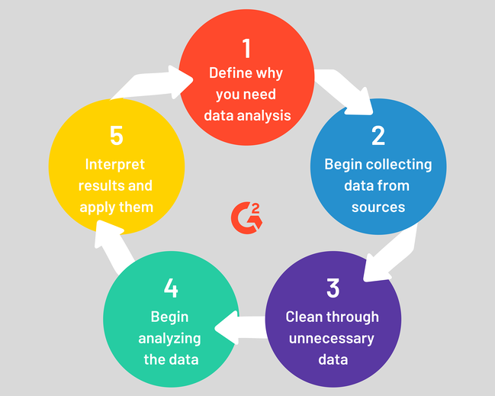

Overview of
Data Analysis Process:

Slide 4
ABSTRACT:
The art of war is of vital importance to the Country. It is a matter of life and death, a road either to safety or to ruin. Hence it is a subject of inquiry which can on no account be neglected. The two World Wars had a significant impact on the World. The race for the arms has been a constant motivation for the advancement in technology by pursuing science.
Our task at hand is to assess the Data from the two major wars in the history of mankind. We approach it by minimalizing the data and categorizing it. We then visualize the data on the world map and in the form of bar charts, bubble charts and comparison of the Wars in the categories of Death Count, Ammunition used, Soldier count, Country count.

Slide 5
INTRODUCTION:
With the help of this project we plan to visualize the effect of world war on countries, regions and even continents. The project also helps to visualize the effect and indirect involvement of countries like India, Australia, New Zealand, though they were way apart from the battle field. The reason could be different for each country in this case, like for India it was because of British Empire ruling India during both wars.

Slide 6
MODULES USED
PANDAS
CSV
NUMPY
CUFFLINKS
PLOTLY
iPYLEAFLET
MATHPLOTLIB
JUPYTER NOTEBOOK ( RECOMMENDED )

Slide 7
System Requirements:
Python3 must be installed.
Any Linux Distribution( Debian/ Ubuntu/ RedHats) / Microsoft Windows 10/8/7/Vista/2003/XP must be installed
All the required Modules must be installed using PIP.
4 GB RAM recommended.

Slide 8
DATASET Preperation
Various Datasets from multiple sources are taken into account.
Different Datasets are compiled into 3 different Datasets based on required parameters.

Slide 9
Data Visualization:
The Data is Analysed by plotting required Graphs and Maps.
Various Graphs : Bar , Scatter, Bubble and Histogram are plotted.
The graphs are shown in the following slides.

Slide 10
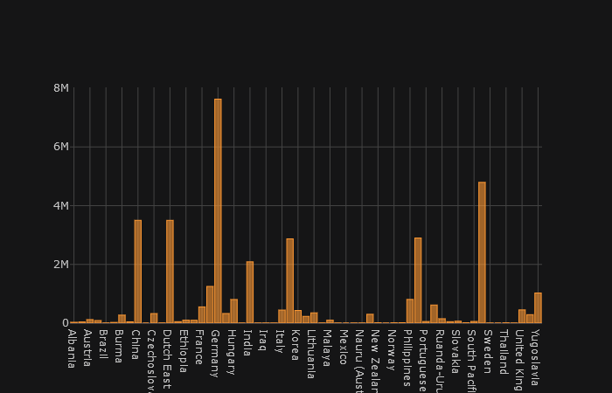
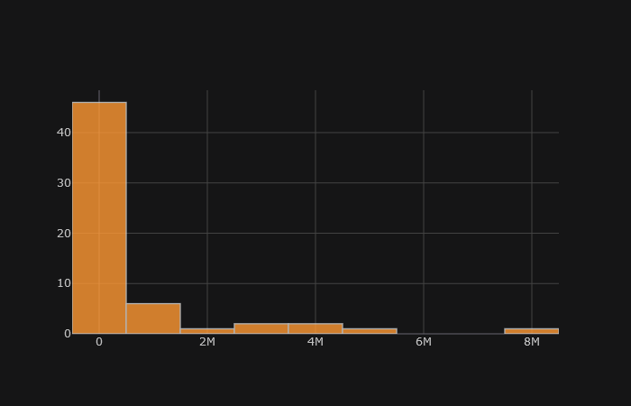
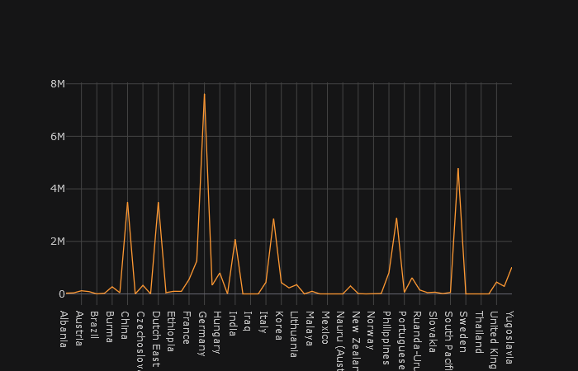
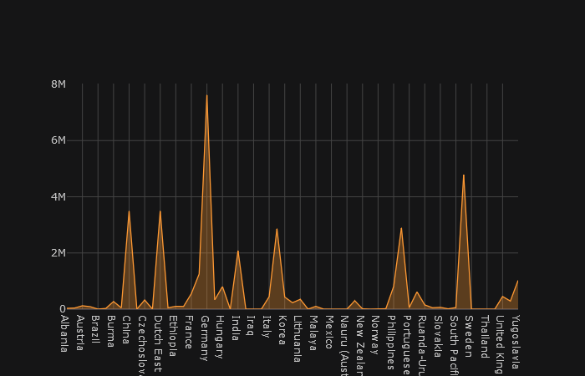
Death Distribution in World War I

Slide 11
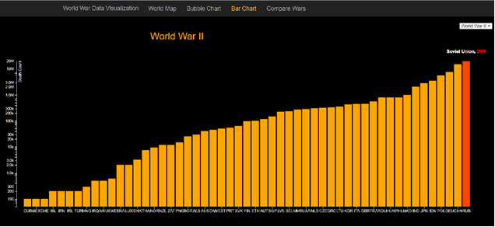
WORLD WAR DEATHS

Slide 12
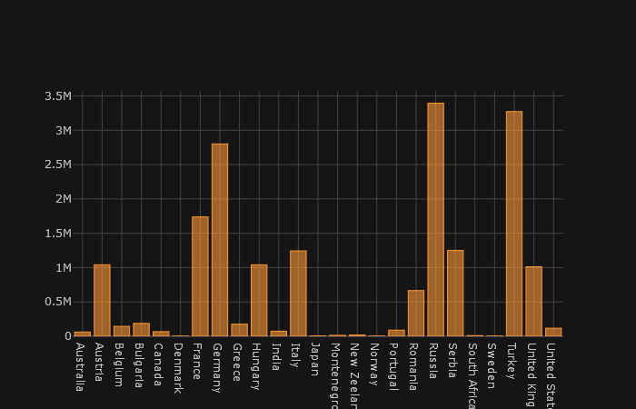
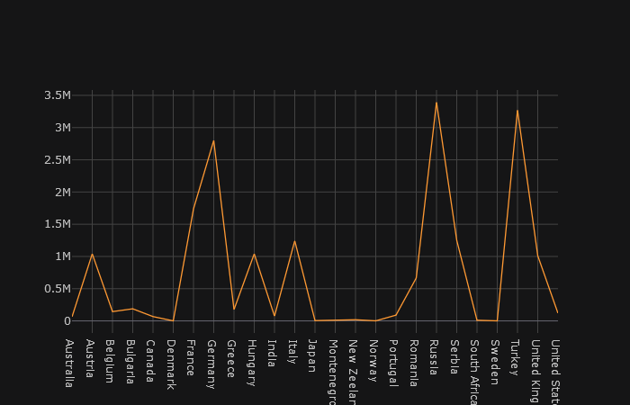
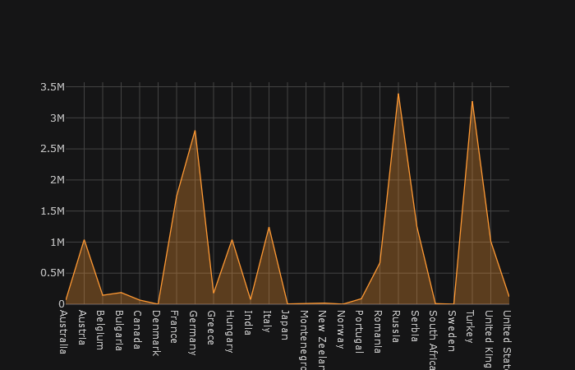
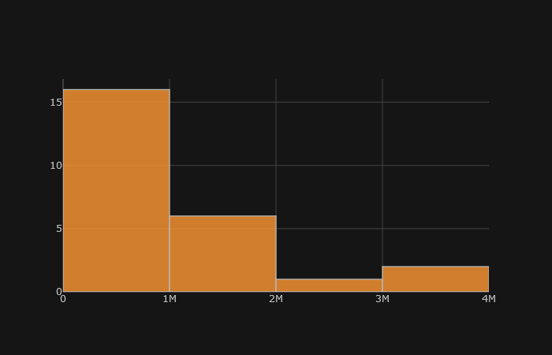
DEATH DISTRIBUTION IN WorlD WAR 2

Slide 13
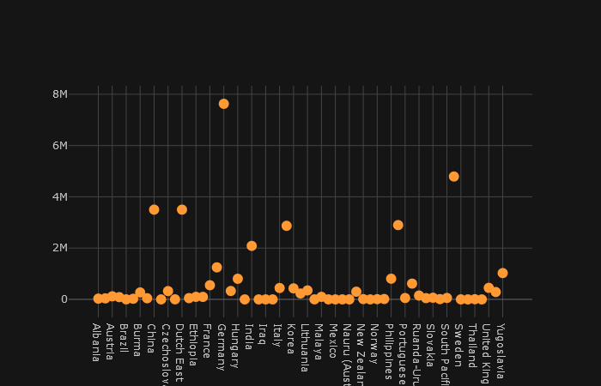
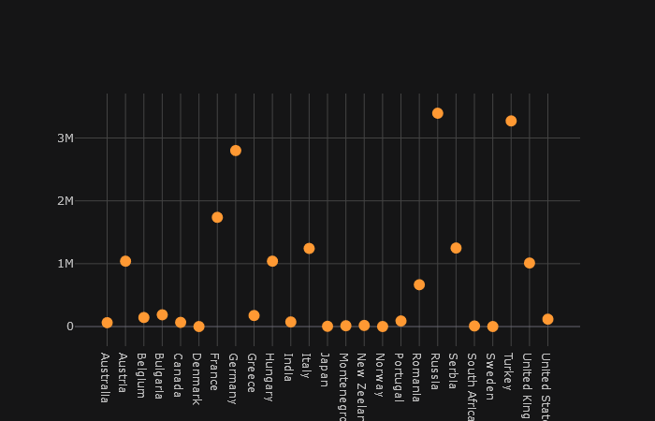
BUBBLE CHARTS
WORLD WAR II
WORLD WAR I

Slide 14
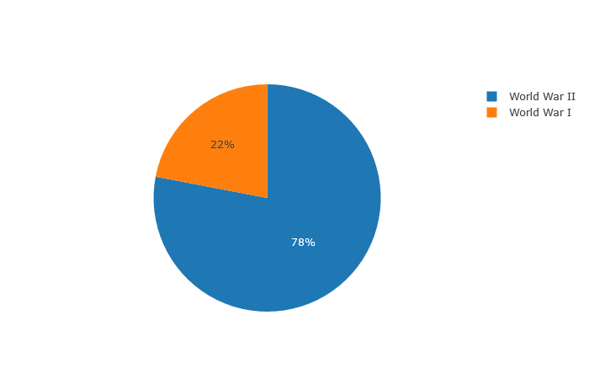
COMPARISION OF THE WORLD WARS

Slide 15
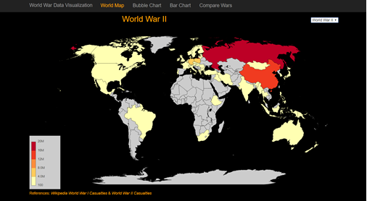
Countries in world wars

Slide 16
Conclusion
This is the Data Analysis and Visualization Implemented using Pandas on Jupyter notebook.
Wikipedia and Kaggle were the sources for the Dataset.
Thus, World War data is successfully Analysed and Visualized.

Slide 17
References:
https://en.wikipedia.org/wiki/World_War_I
https://en.wikipedia.org/wiki/World_War_II_casualties
https://data.world/search?q=world+war

Slide 18
The Code and Repository for the Project are available on my GITLAB/ GITHUB Account.
Project Links:
GITLAB LINK:
https://code.swecha.org/sameerkousik/world-war-data-analysis
GITHUB LINK:
https://github.com/sameerkousik/World-War-Data-Analysis

Slide 19

Thank You

